Slide 1
Making Better Dirt Five components to make us better Soil Lesson 2
Simplicity of the Word Ministry
www.simplicityoftheword.com

Slide 2
Five Components to making us better Soil
Love God
Love Yourself and Others
Learn to Control the Tongue
Get an Understanding
See the world through the eyes of others (Compassion & Empathy)

Slide 3
Love Yourself and Others
Mark 12:29-31

Slide 4
The First and the Greatest
“And thou shalt love the Lord thy God with all thy heart, and with all thy soul, and with all thy mind, and with all thy strength: this is the first commandment.
And the second is like, namely this, Thou shalt love thy neighbor as thyself. There is none other commandment greater than these.” Mark 12:30-31
First Gas powered car – Henry Ford
G.O.A.T Entertainer – Michael Jackson
First Apple Computer – Steve Jobs
G.O.A.T Basketball – Michael Jordan
First Human on the moon – Neil Armstrong
G.O.A.T Boxer – Muhammad Ali

Slide 5
The 10 Commandments (Exodus 20:2-17)
You Shall Have No Other Gods Before Me
You Shall Make No Idols or Graven Images
You Shall Not Take The Name Of The Lord Your God In Vain
Keep The Sabbath Day Holy
Loving God
5. Honor Your Father And Your Mother
Loving Yourself
6. You Shall Not Murder
You Shall Not Commit Adultery
You Shall Not Steal
You Shall Not Bear False Witness Against Your Neighbor
You Shall Not Covet
Loving Others

Slide 6
Overview
Vision
Two important factors for Learning to Love Ourselves and Others
Balance

Slide 7
Vision
Made in God’s Image and Likeness (Gen 1:26-27)
“Image - a visual representation of something, A reflection”
In the Garden Adam was able to clearly see himself as a reflection of God

Slide 8
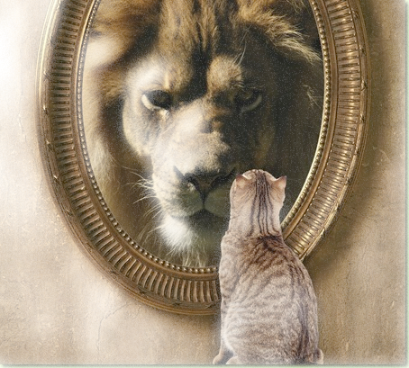
Vision
However, with the advent of Sin, man’s Vision of himself as a reflection of God became distorted.
Sin breaks Fellowship with God

Slide 9
Vision
“For now we see through a glass, darkly; but then face to face: now I know in part; but then shall I know even as also I am known.”
1 Corinthians 13:12
“Beloved, now are we the sons of God, and it doth not yet appear what we shall be: but we know that, when he shall appear, we shall be like him; for we shall see him as he is.”
1 John 3:2

Slide 10
Vision
Loving God with our Heart, Mind, Soul and Strength
As we learn to Love God we transform our Heart, Mind, Soul and Strength to see Ourselves and Others through God’s eyes.
“And be not conformed to this world: but be ye transformed by the renewing of your mind, that ye may prove what is that good, and acceptable, and perfect, will of God.
Romans 12:2
The Word of God is like our Spiritual Contact Lens
“Provides Corrected Vision!”

Slide 11
Balance

Slide 12
Balance
Me
You
Thou shalt love thy neighbor as thyself.
AS

Slide 13
Balance
When I begin to love Me More than You
Pride, Arrogance, Self Centered
“Planet ‘Me’ – Population 1”
Me
You
AS

Slide 14
Balance
When I begin to love You more than Me
Idolatry, Low Self Esteem and Confidence… Depression
“Everyone else is better than me”
You
Me
AS

Slide 15
Vision “and” Balance
The Holy Scriptures
Learn to Love God
Heart – Soul - Mind - Strength
Corrected Vision and Proper Balance brings us into Fellowship - 1 John1:3
“That which we have seen and heard declare we unto you, that ye also may have fellowship with us: and truly our fellowship is with the Father, and with his Son Jesus Christ.
Me
You
Thou shalt love thy neighbor as thyself
AS

Slide 16
Balance
Love God
Fellowship
“That which we have seen and heard declare we unto you, that ye also may have fellowship with us: and truly our fellowship is with the Father, and with his Son Jesus Christ. 1 John1:3
Me
You
Thou shalt love thy neighbor as thyself
AS

Slide 17
Summary
Loving Yourself and Others
Vision
Balance
Corrected Vision and Proper Balance brings us into Fellowship
1 John1:3
Thou shalt love thy neighbor as thyself

